Slide 1


Analyzing & Predicting Airline Passenger Satisfaction
CS5593-001
Data Mining
Fall 2025
Presented By
Abirami Thiyagarajan Nethra Janardhanan Sai Krishna Bharadwaj Burra
YOUTUBE LINK: https://youtu.be/TPWopQruvhI

Slide 2
Outline
Introduction & Motivation
Related Work
System Architecture & Dataset
Methods: Regression, K-Means Clustering, Random Forest
Experimental Results & Insights
Web Application Demo (Predict, Reports, Dashboard)
Conclusion & Future Work

Slide 3

Introduction
Airlines run on thin margins, so passenger satisfaction is key for loyalty and revenue.
Prior work often treats service quality and delays separately instead of using one unified model.
Our project builds an end-to-end data-mining system on the Airline Passenger Satisfaction dataset using Linear Regression, K-Means Clustering, and Random Forest Classification in a React–Flask web app to analyze and predict satisfaction.

Slide 4
Related Work
Study | Focus Area | Limitation
Oliveira et al. (2023) | Airport service quality and delay perception | Focuses on perception and survey bias; no prediction model or passenger segments
Yas et al. (2022) | Service quality → satisfaction → loyalty (SEM) | High-level relationships only; no predictive model, no clustering, no service–delay integration
Eshaghi et al. (2024) | Meta-analysis of airline satisfaction drivers | Shows service and delays both matter but treats them separately; no unified model
Şahinbaş (2022) | K-Means vs DBSCAN for airline customer segmentation | Uses clustering but no PCA, no internal metrics, and no link to satisfaction or delay patterns
Qu (2024) | Linear regression algorithms | Focuses on standard linear regression theory, but does not address how to handle highly correlated features or use regularised and piecewise models for more realistic relationships.
Our Contribution​ - First system to jointly model service and delays, use PCA-validated k means clustering, build tuned linear regression + Random Forest, and deploy a working Flask–React web app​

Slide 5
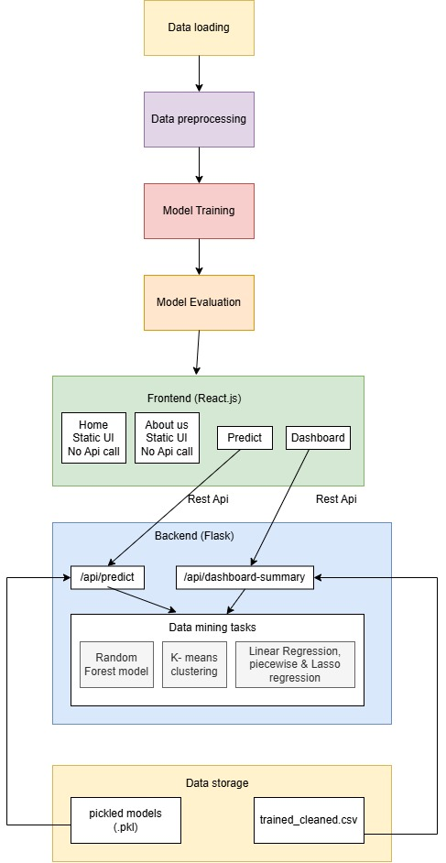
System Architecture

Slide 6
Proposed Work
Regression Modelling
Implemented Linear, Ridge, Lasso, and Piecewise regression to quantify how service quality and delays influence passenger satisfaction.
Clustering Analysis (PCA + K-Means)
Used PCA to reduce correlated service features and applied K-Means with ensemble validation to discover meaningful passenger segments.
Random Forest Classification
Built a from-scratch CART + Random Forest model, tuned with cross-validation, to accurately predict whether a passenger is satisfied or not.

Slide 7
Clustering – K Means Clustering
Before clustering, we applied PCA to remove redundancy from highly correlated features.
PCA pipeline produced 14 principal components explaining 91% variance.
These PCA scores were then used as the input to K-Means for more stable and meaningful clusters.
Implemented K-Means from scratch (random centroid initialization, assignment, centroid update, convergence check).
Ran one single K-Means run for each k = 2 to 10.
Calculated SSE/Inertia
Plotted the Elbow Curve from these single-run SSE values.
Used the elbow shape to get a rough idea of the possible number of clusters.

Slide 8
Clustering – K Means Clustering
Enhanced K-Means
For each k = 2 to 10, ran multiple seeds
For each k, kept the best run with the lowest SSE, reducing randomness.
Computed Calinski–Harabasz, Silhouette, and Davies–Bouldin scores using the best run for that k.
Compared all metrics across k to decide which k had the strongest cluster separation.
Key Difference
Normal = 1 run per k to unstable results
Enhanced = multiple seeds and validation metrics to stable, well-validated clustering

Slide 9
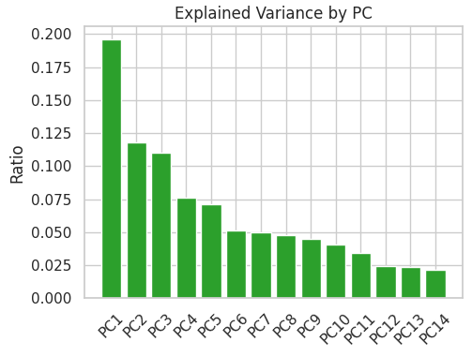
Results - K Means Clustering
Confirms that 14 PCs retain ~91% of total variance, justifying dimensionality reduction.

Slide 10
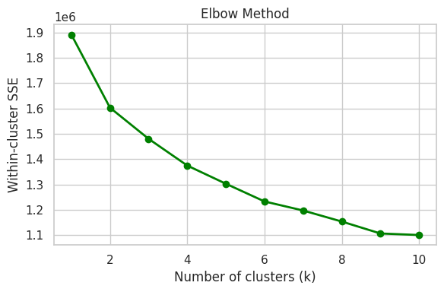
Results - K Means Clustering
Elbow curve (single-run): Shows how SSE decreases with k, giving an initial idea of where the elbow occurs.

Slide 11
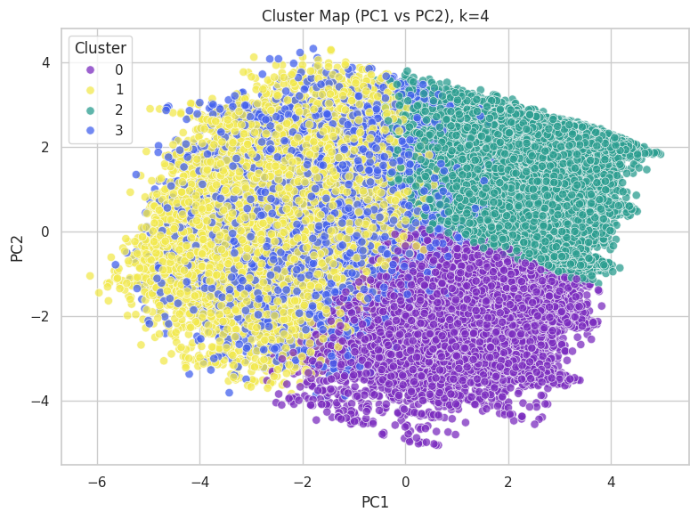
Results - K Means Clustering
Visualizes how passengers group into four clusters in PCA space for exploratory comparison.

Slide 12
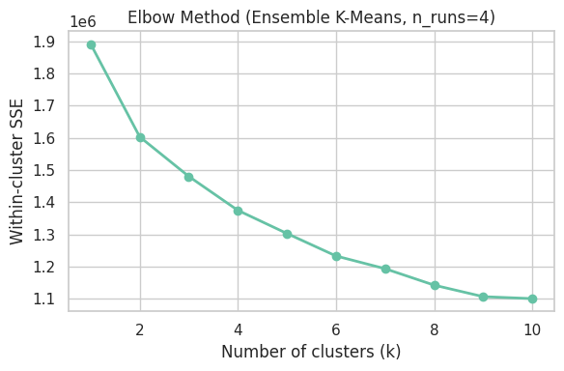
Results - K Means Clustering
Elbow curve (ensemble K-Means): Uses multiple seeds for more stable SSE values across k, improving reliability.

Slide 13
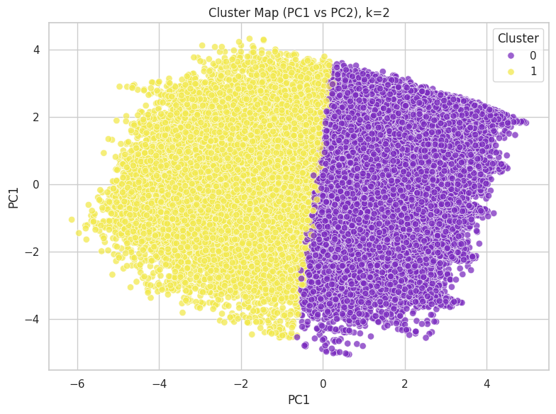
Results - K Means Clustering
Final cluster map for k=2: Shows the clean separation produced by the chosen 2-cluster solution used for interpretation.

Slide 14
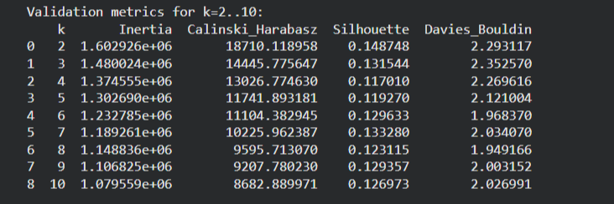
Results – K Means Clustering
Internal validation metrics (Inertia, Calinski–Harabasz, Silhouette, Davies–Bouldin) for K-Means across k = 2…10, showing strongest cluster separation at k = 2.

Slide 15
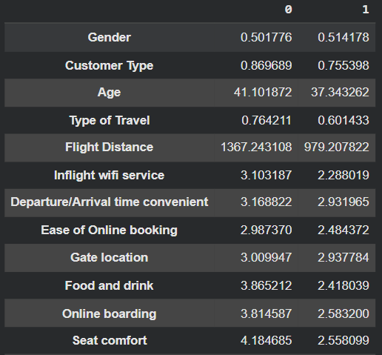
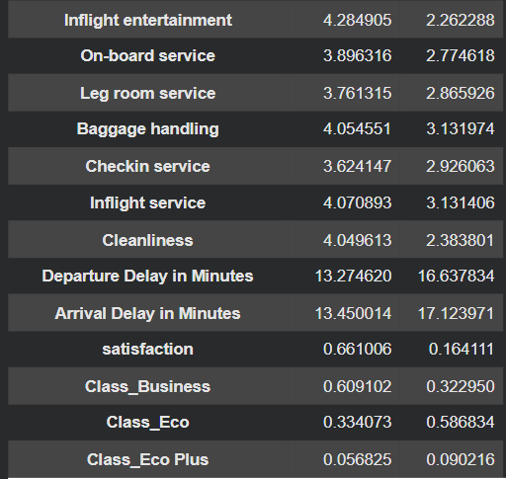
Clustering – K Means Clustering
Cluster Profile Table

Slide 16
Regression
The goal of this part is to measure how changes in service quality and flight delays influence passenger satisfaction.
We construct two main features : a Total Service Score that adds up all fourteen service rating variables, and a Total Delay value that adds the departure delay and the arrival delay.
These features are used as inputs to regression models where the target is the numeric satisfaction label, coded as zero for not satisfied and one for satisfied.

Slide 17
Regression
Converted satisfaction to a numeric 0/1 target and built two main features: Total Service Score and Total Delay.
Trained a baseline linear regression model to link these features to satisfaction.
Added Ridge and Lasso regression to handle correlated service variables and stabilise the coefficients.
Applied piecewise regression on Total Delay with a 120-minute split to capture any non-linear delay effects.
Compared all models using MSE, RMSE, and R² and selected the best settings based on these metrics.

Slide 18
Regression
Regression captures about one quarter of the variation in satisfaction (best Ridge: MSE 0.1848, RMSE 0.4298, R² 0.2475).
From the Total Service Score plot, satisfaction rises steeply for higher service scores; with R² 0.65, service quality is the main driver.
The Delay Category plot shows a mild downward trend (R² 0.34): longer delays reduce satisfaction, but the effect is weaker than service quality.
The Piecewise Delay Regression plot shows almost no R² gain after splitting at 120 minutes, so delay effects appear gradual rather than a sharp drop.

Slide 19
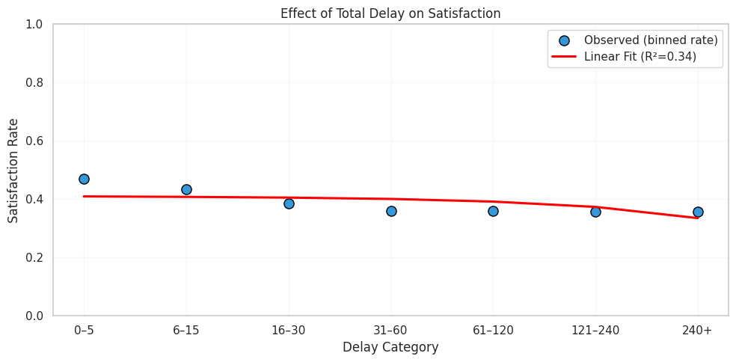
Regression

Slide 20
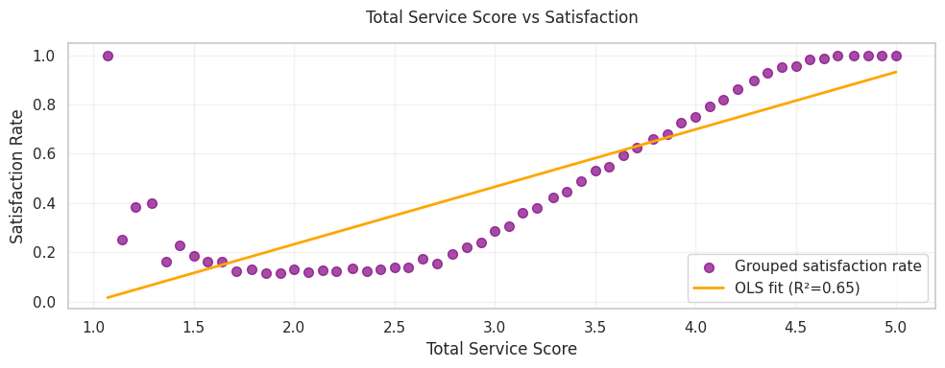
Regression

Slide 21
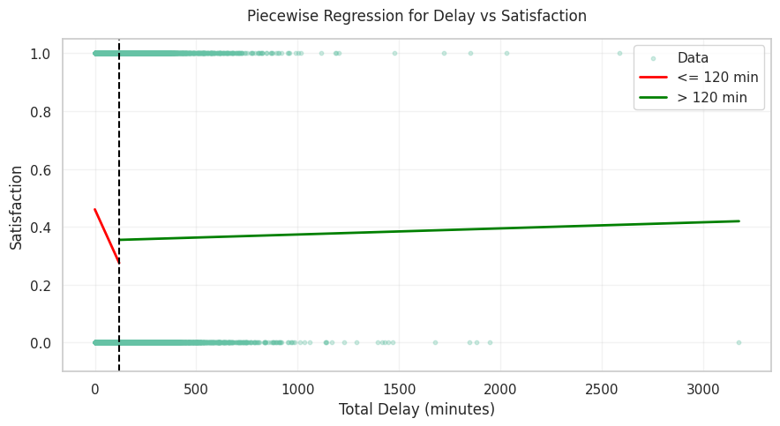
Regression

Slide 22
Classification-Random Forest
Random Forest was chosen because it handles high-dimensional tabular data extremely well, especially mixed features like service ratings, delays, and travel attributes.
It reduces overfitting by combining many decision trees, each trained on different subsets of data and features.
The airline dataset shows many correlated service features (e.g., entertainment, comfort, cleanliness); Random Forest naturally stabilizes predictions under such correlations.
It provides feature importance, helping us interpret which service or operational factors drive satisfaction.
Our fully from-scratch implementation let us control Gini impurity, threshold scanning, bootstrapping, and OOB scoring directly.

Slide 23
Classification-Random Forest
Each decision tree is a CART tree that uses Gini impurity to choose the best split.
The tree only splits when it clearly improves purity and meets minimum leaf size rules.
The forest is created by training many trees on bootstrap samples, each using different subsets of features, which makes the model stronger and more stable.
We use Out-of-Bag (OOB) evaluation trees predict on data they never saw, giving a natural, unbiased accuracy estimate.
This approach fits our dataset well because it handles delay values, service ratings, demographics, and travel attributes without needing heavy preprocessing.

Slide 24
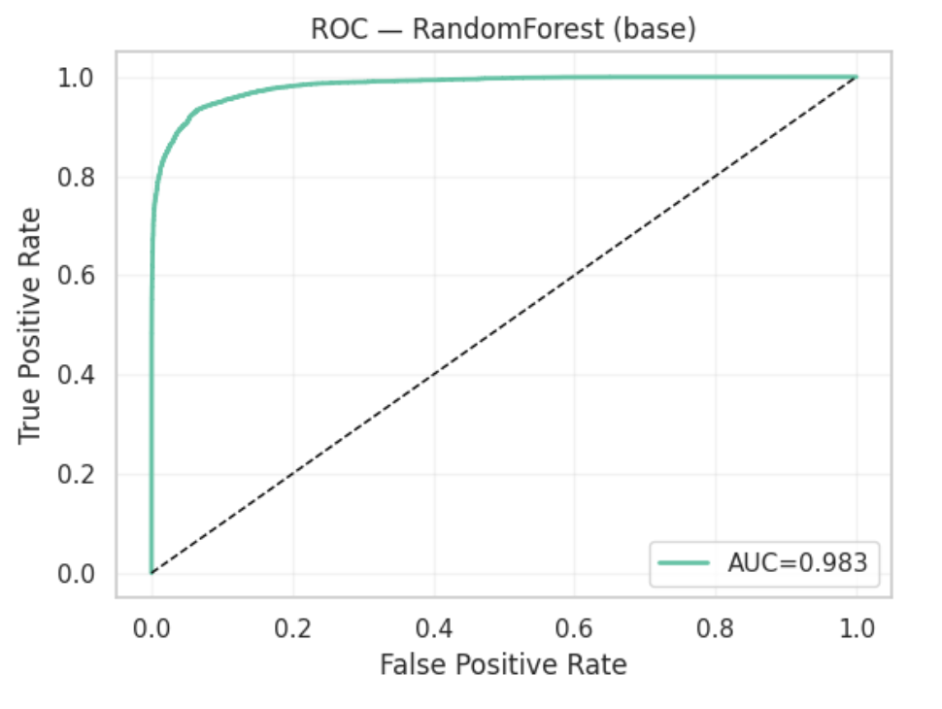
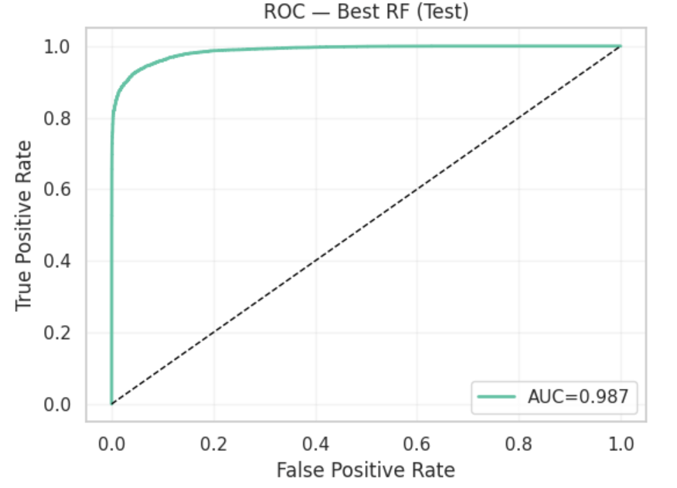
Performance

Slide 25
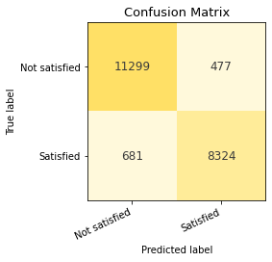
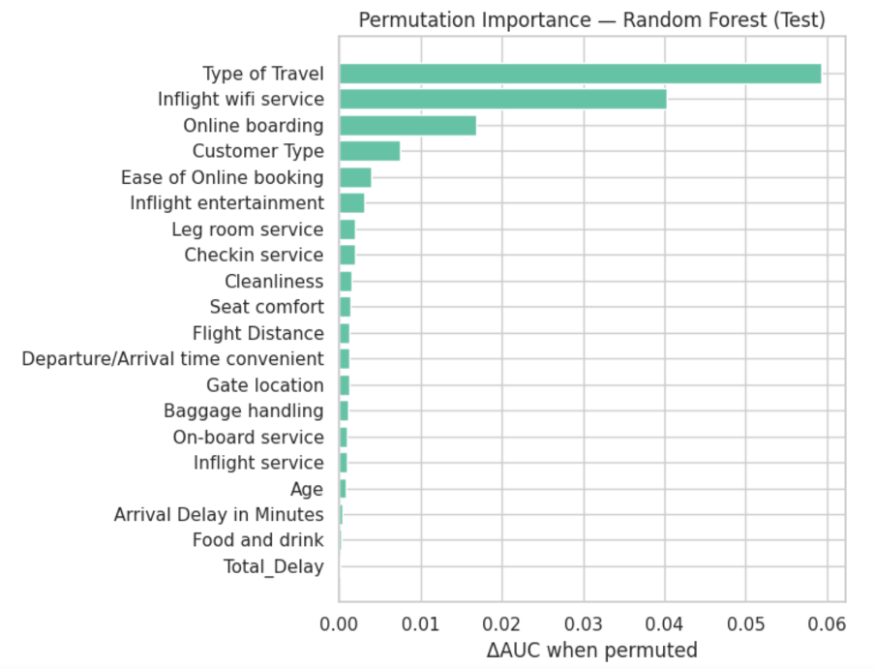
Performance

Slide 26
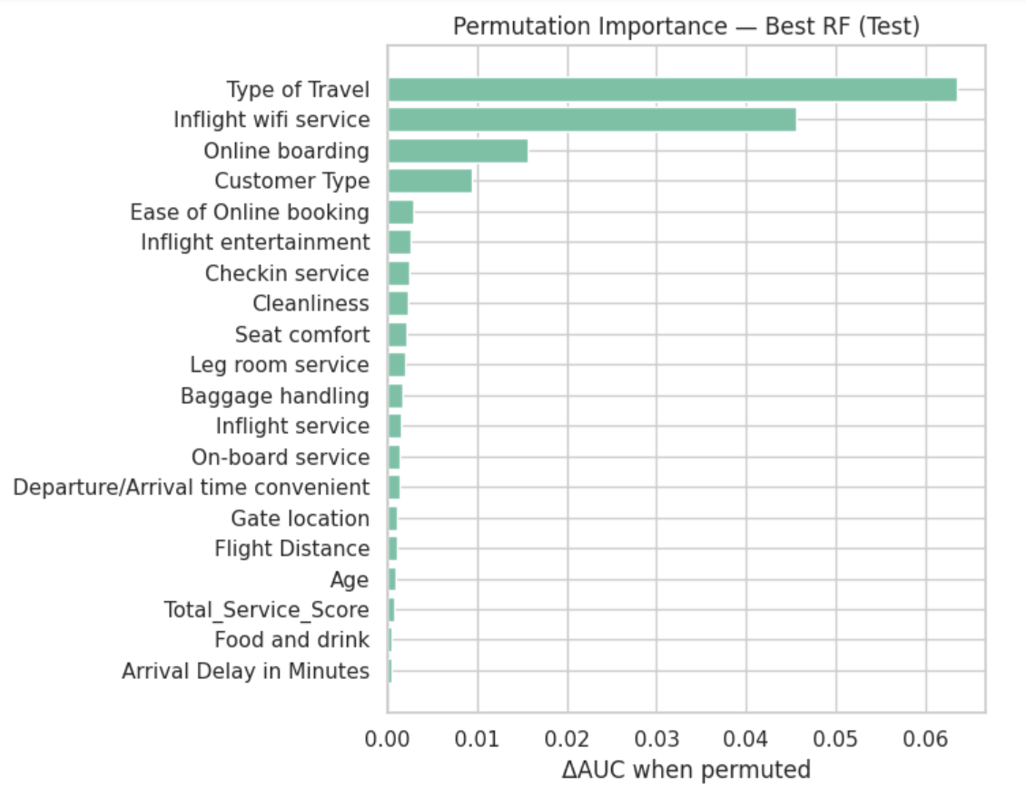
Performance

Slide 27
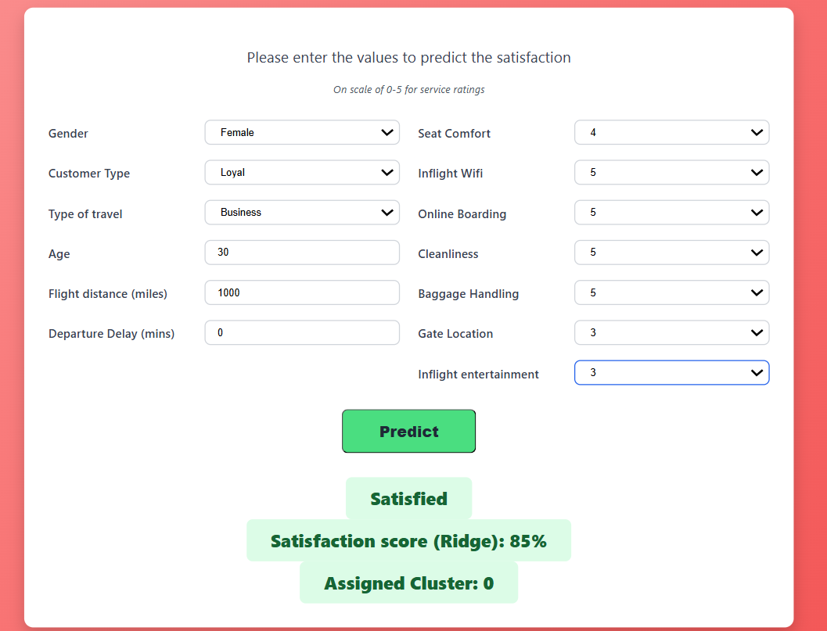
DEMO SCREENSHOTS

Slide 28
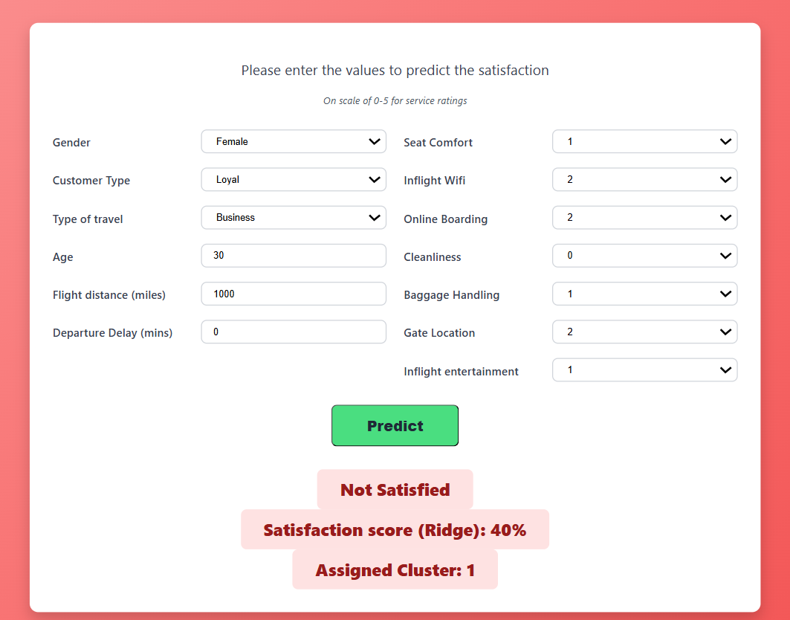
DEMO SCREENSHOTS

Slide 29
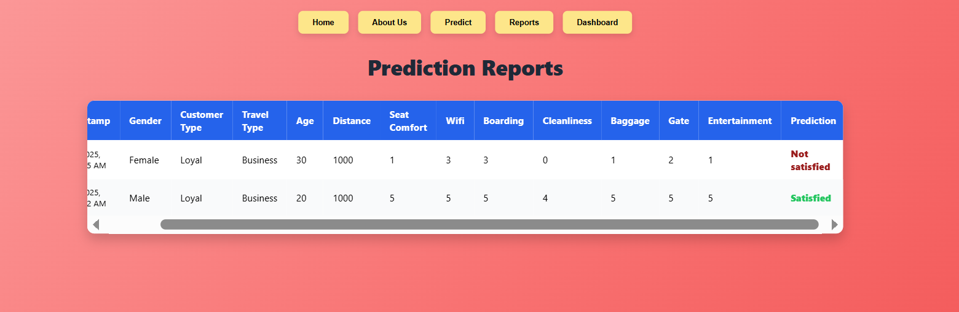
DEMO SCREENSHOTS

Slide 30
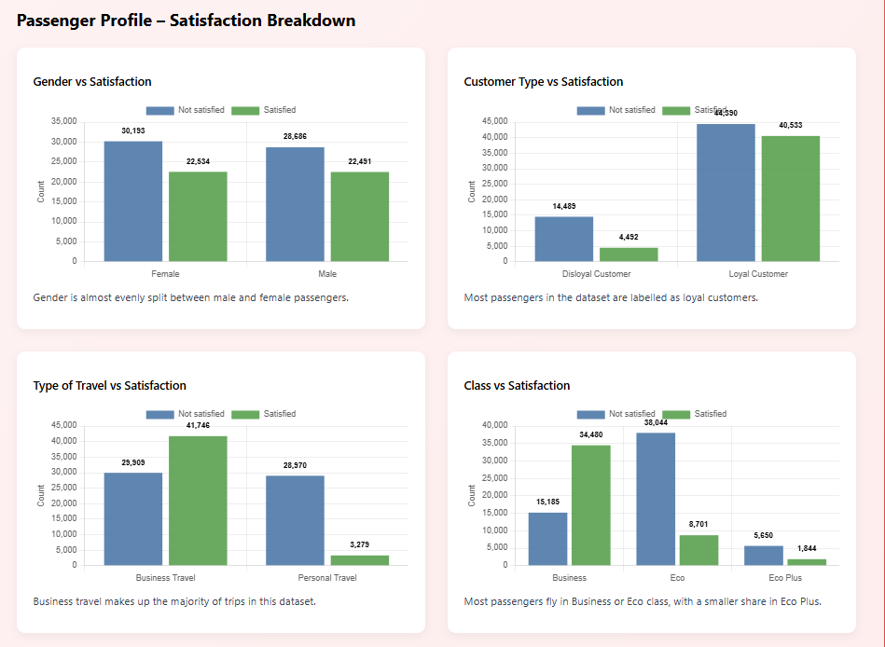
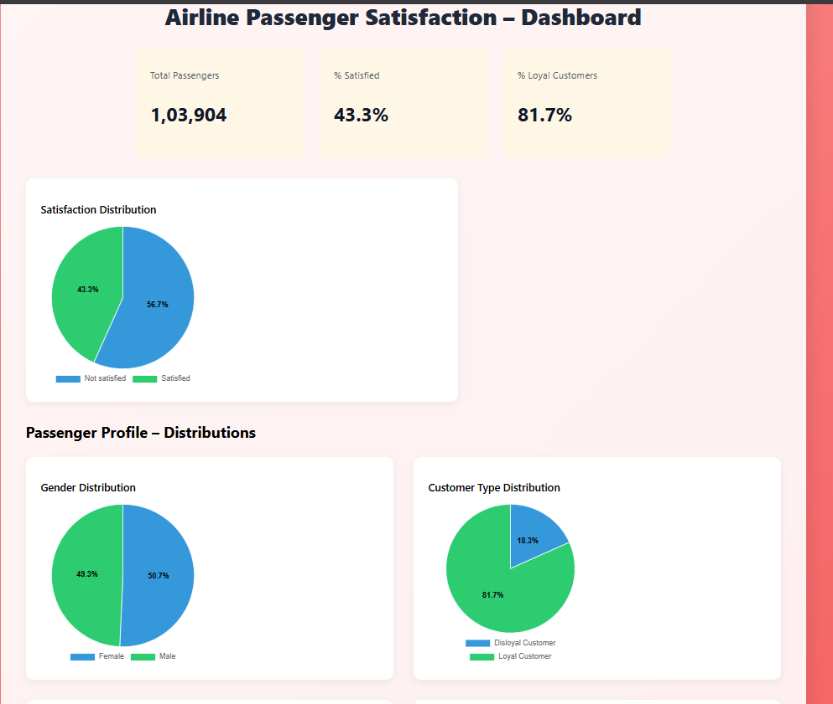
DEMO SCREENSHOTS

Slide 31
Conclusion & Future Work
Built an end-to-end data mining pipeline with preprocessing, EDA, PCA, regression, K-Means, and a from-scratch Random Forest.
Regression showed how service and operational factors impact satisfaction.
K-Means found two key segments: high-service loyal/business flyers vs. lower-service economy/personal travelers.
Random Forest delivered strong prediction accuracy on passenger satisfaction.
Deployed models in a React–Flask web app for real-time predictions and interactive dashboards.
Future work: integrate with airline CRM/check-in systems and run A/B tests to refine thresholds and recommendations.

Slide 32
THANK YOU

